Slide 1






Do neighbors share more songs?
Jiayi Zhang | KSCB
with supervision & data access from Dr. Christophe Bousquet

Slide 2
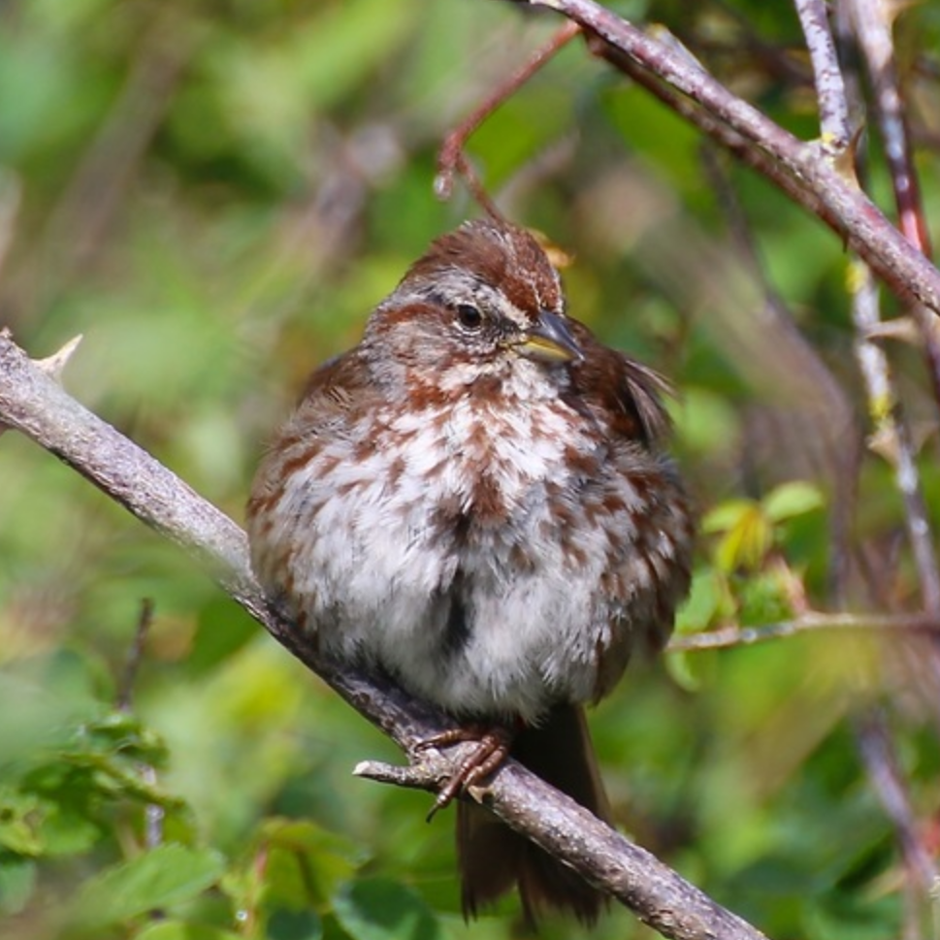
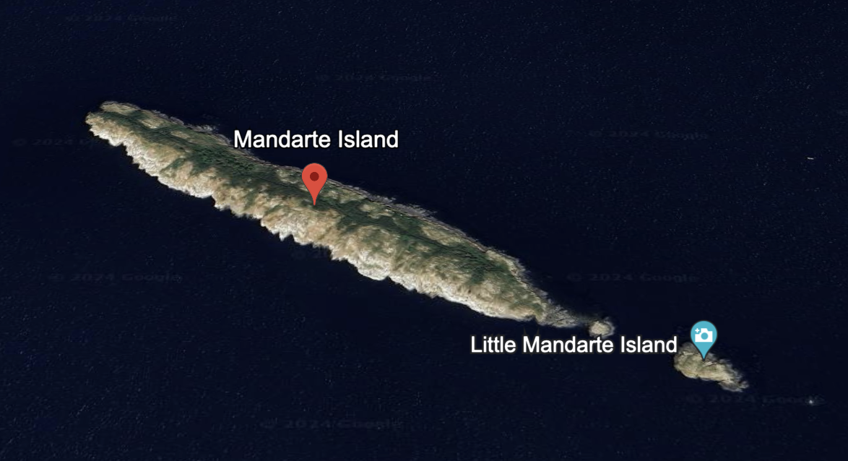
Mandarte Island (BC, Canada)
mandarte-island.weebly.com
Song sparrows (Melospiza melodia)
~100m
Google Earth
Notes:
700m long and 100m wide

Slide 3
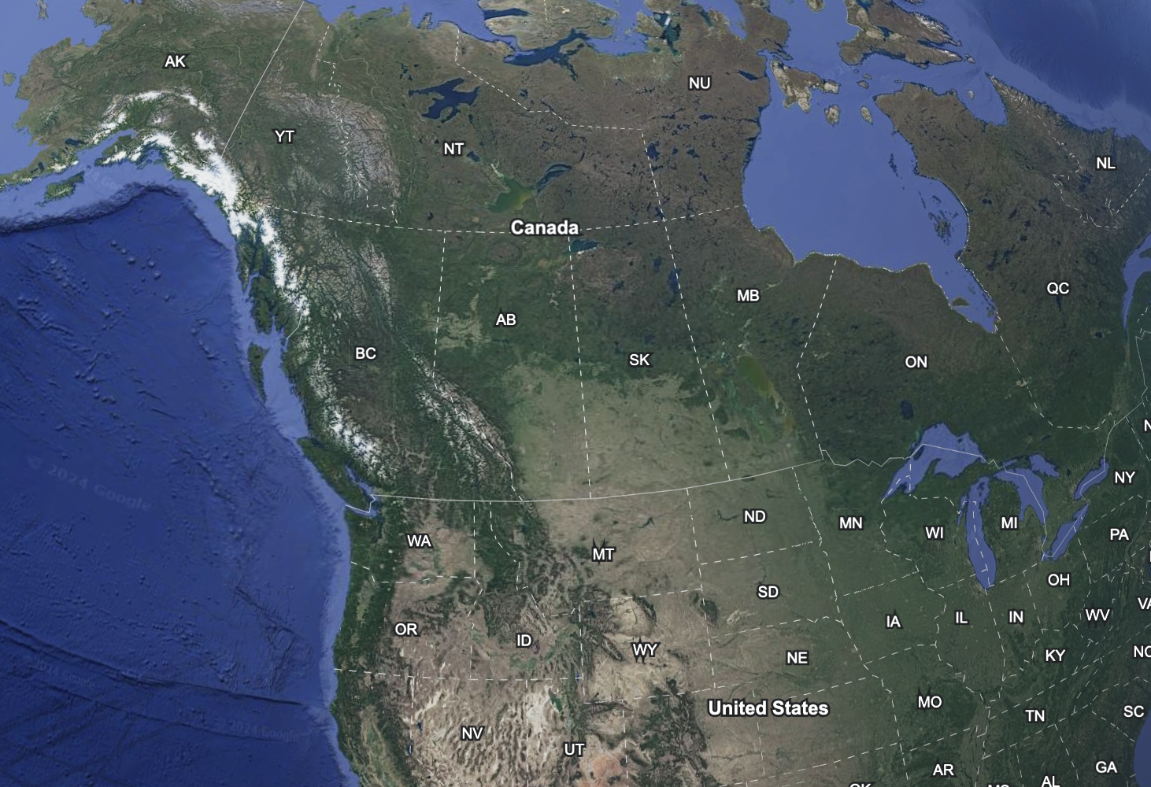
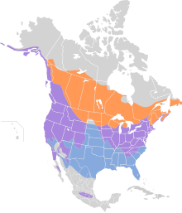
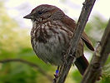
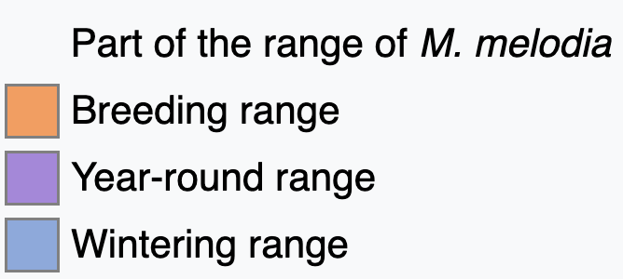
They are all over North America! (sr: wiki)
📍

Slide 4
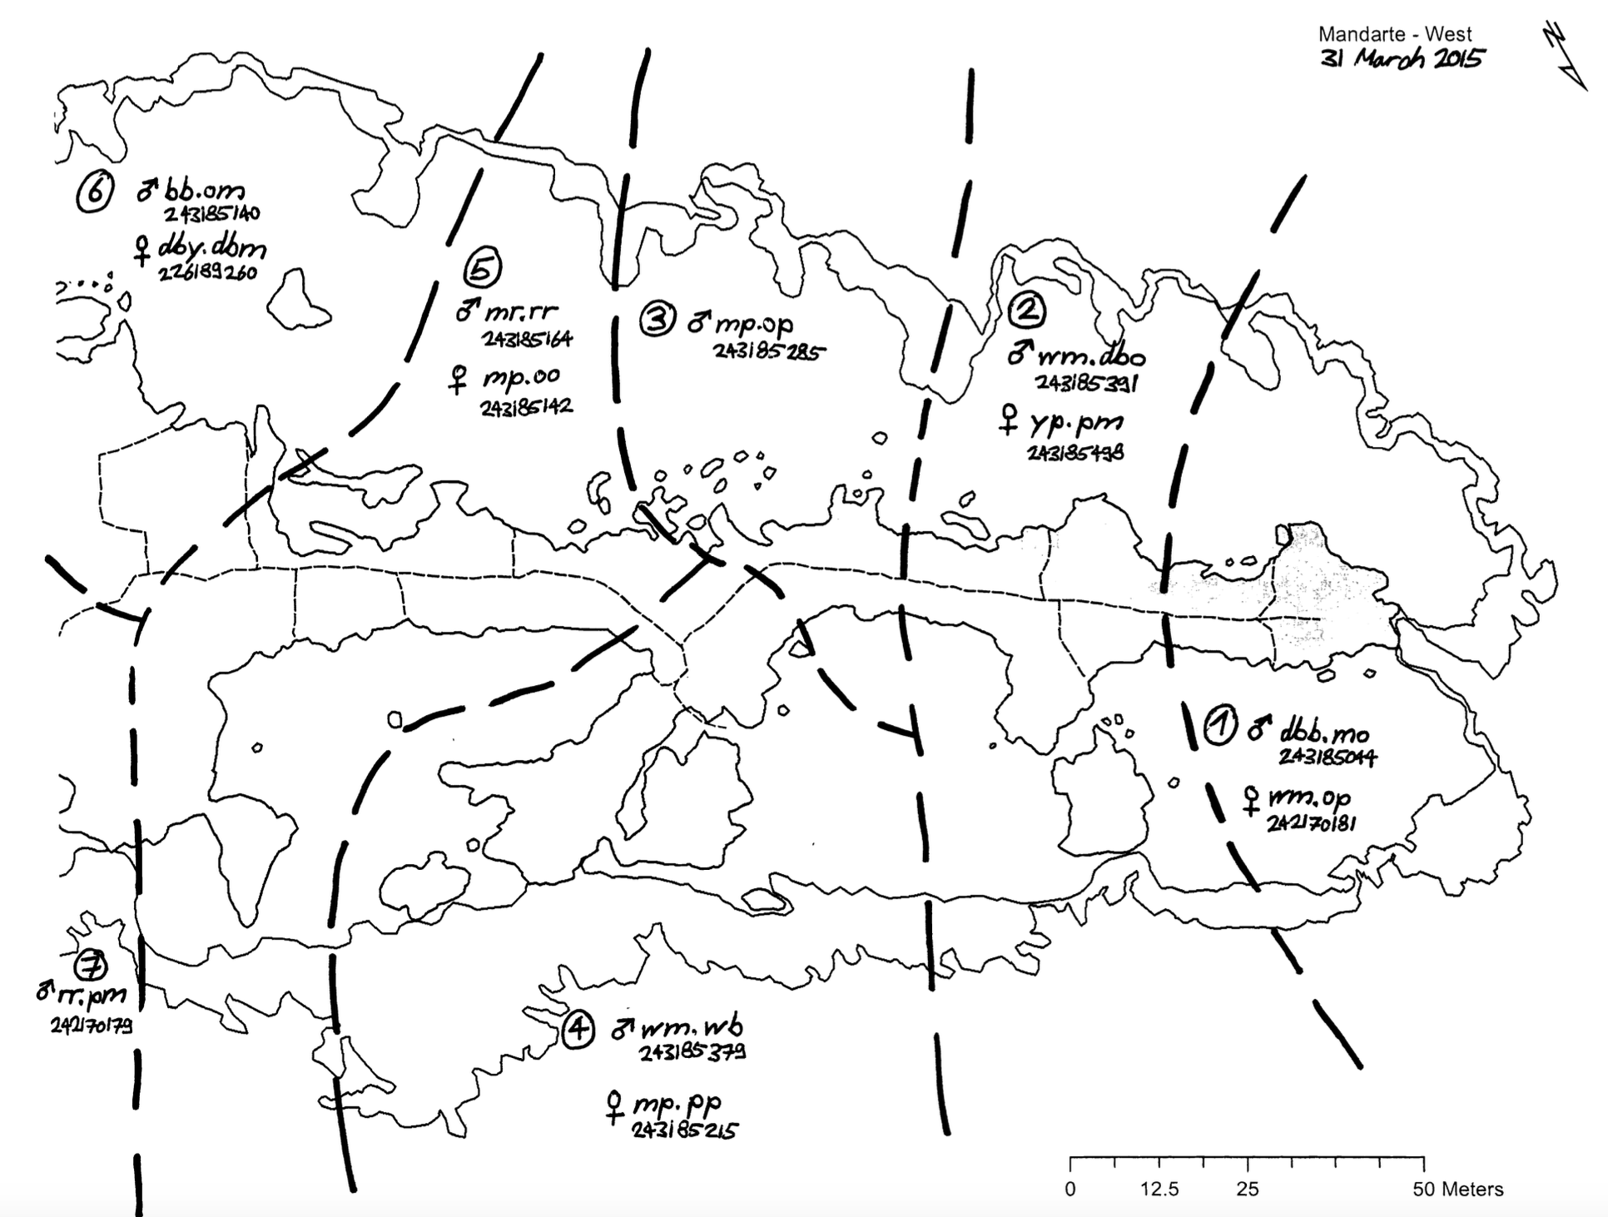
Nearly all song sparrows of Mandarte has been monitored (throughout its life) since 1975!
Males (resident population) are territorial year-round. Songs are used for territorial defense and courtship. (Females also sing but are less well-studied)
Song sparrows are vocal learners (they learn notes/syllables and syntax).
Example territory map of
Mandarte – West (2015)
sr: Mandarte Research Team
Notes:
ARCESE 1989

Slide 5
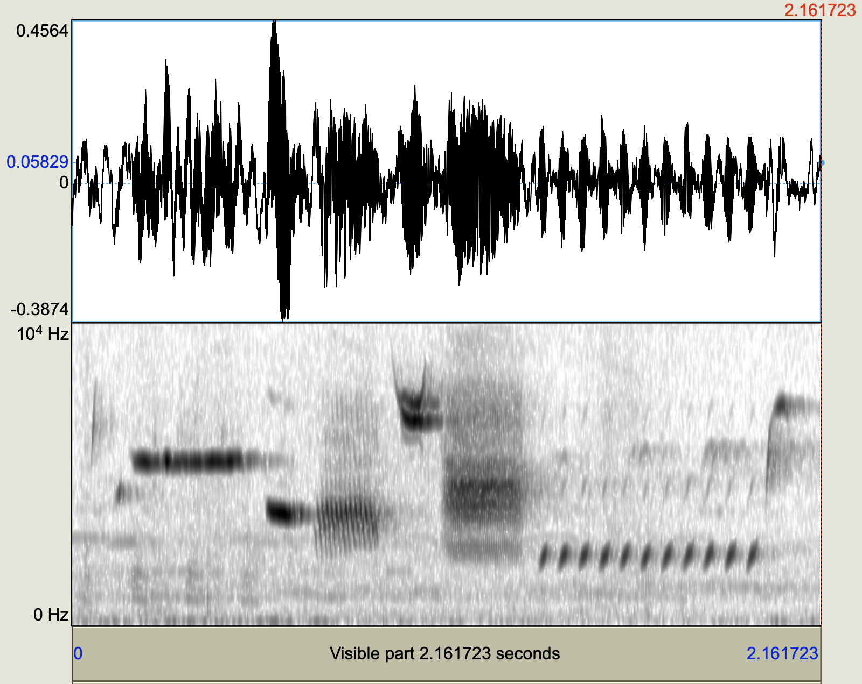

Notes:
Get to know a ”song”

Slide 6
Question: Does territorial proximity predict song repertoire overlap?
Translation: Would vocalizations of neighboring song sparrows be more similar than non-neighbors?
Data: Field recordings of songs from male song sparrows on the Mandarte island, territory map (focus: 2015)
Technical problems to tackle:
How to denoise field recordings?
How to represent songs (so that they are comparable)?
How to compare songs?

Slide 7
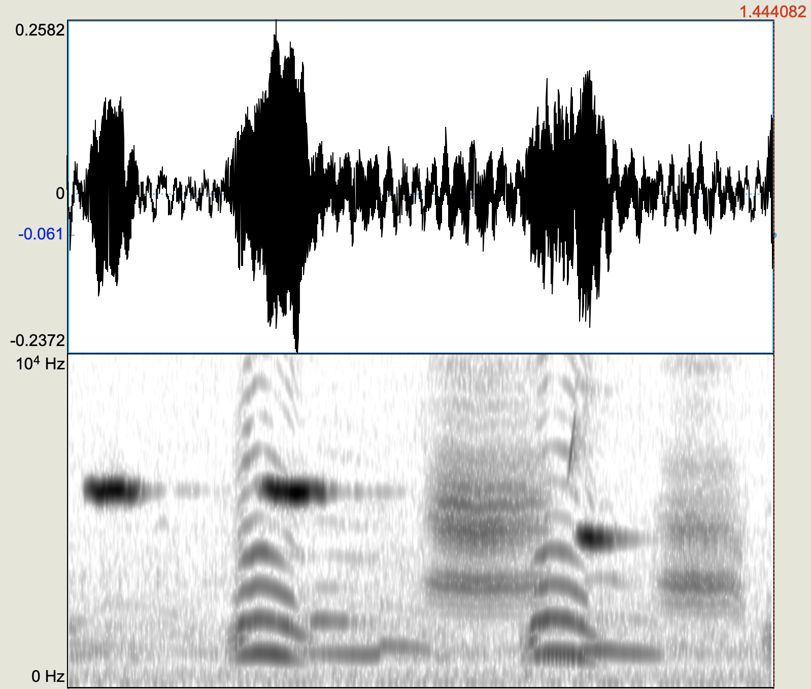
Denoise

Slide 8







Denoise

Slide 9
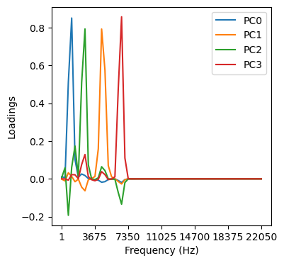
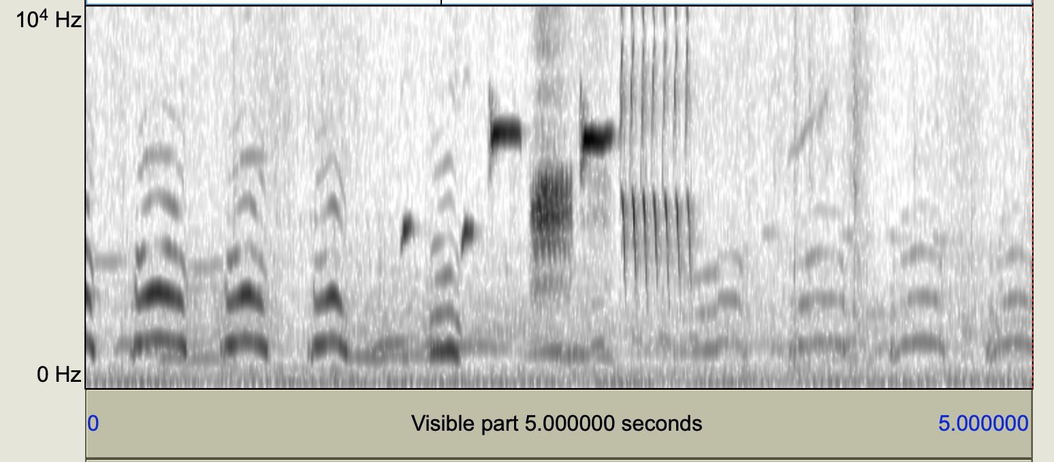
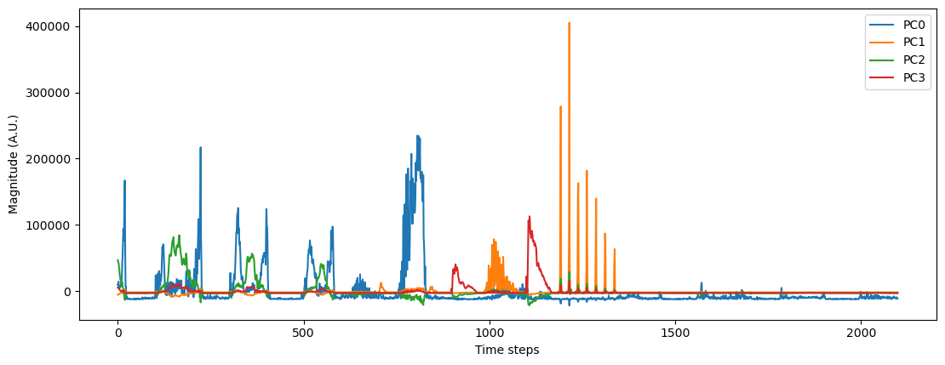
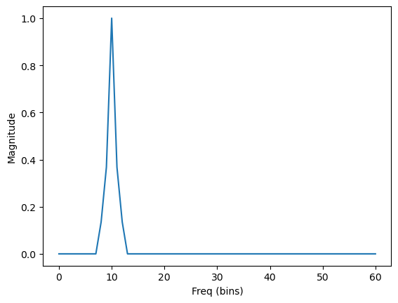
PCA is (almost) all you need.
Denoise
Top 4 PCs
Ex. Exponential window

Slide 10
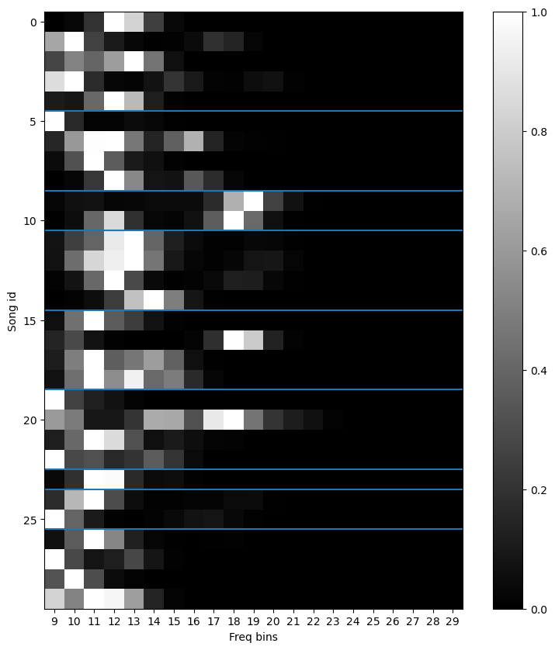
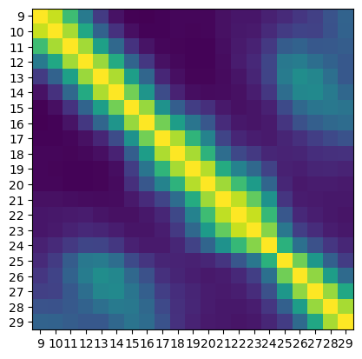
Denoise + Represent
% Variance explained by different filters
Average correlation between filtered songs.

Slide 11
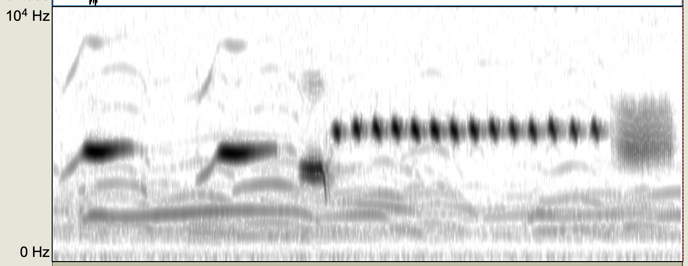
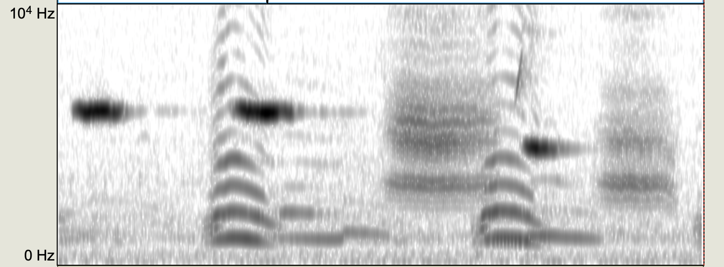
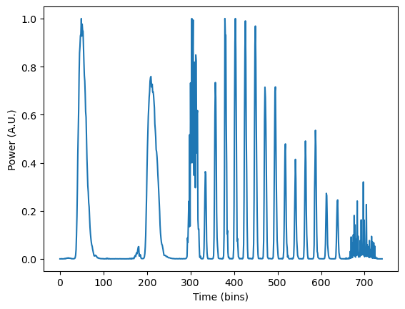
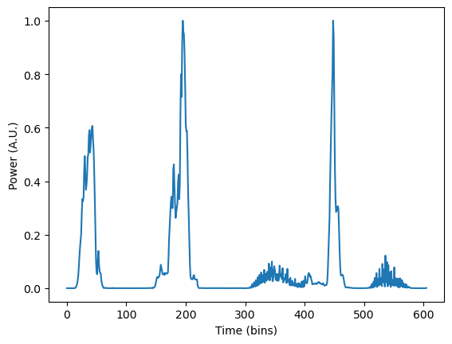
Denoise + Represent

Slide 12
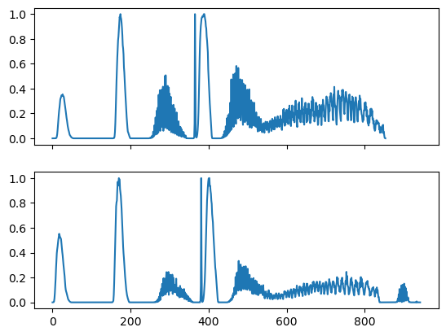
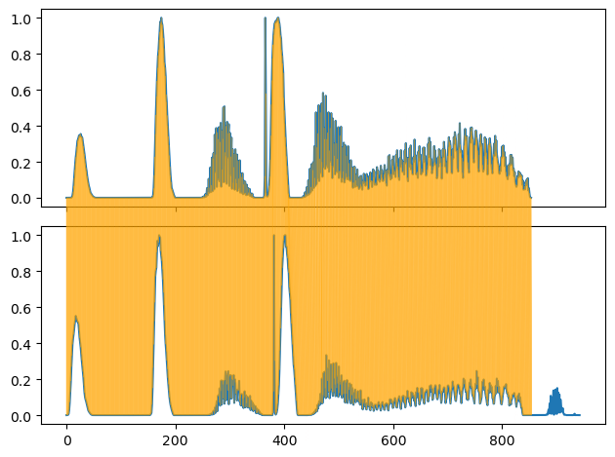
Denoise + Represent
Compare
Need to compare the “similarity” (i.e. distance) between 1D time-series of different lengths.
Idea: Dynamical time-warping (local/sub-sequence alignment)
😀 PROBLEM SOLVED!?
DIST = 5.5

Slide 13
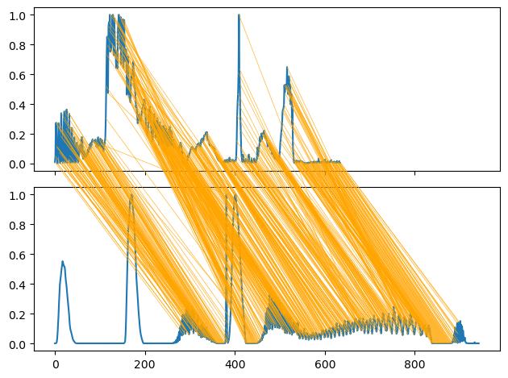
Denoise + Represent
Compare
🤯 NOT SO FAST…
DIST = 5.39
Notes:
Ben: how about just considering an envelope (would make dtw much easier)

Slide 14
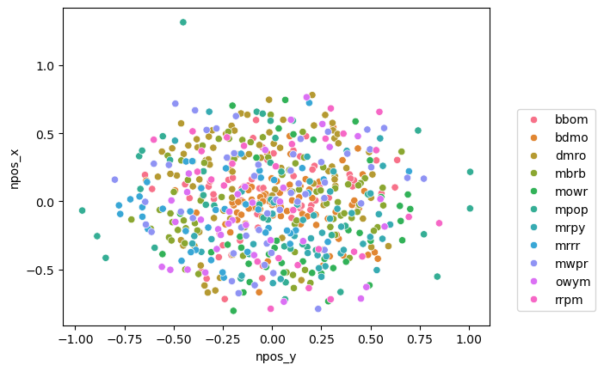
Denoise + Represent
Compare
Visualize
Given a distance matrix of all songs with each other, how do we visualize them?
Idea: (non-metric) multi-dimensional scaling (nMDS)

Slide 15
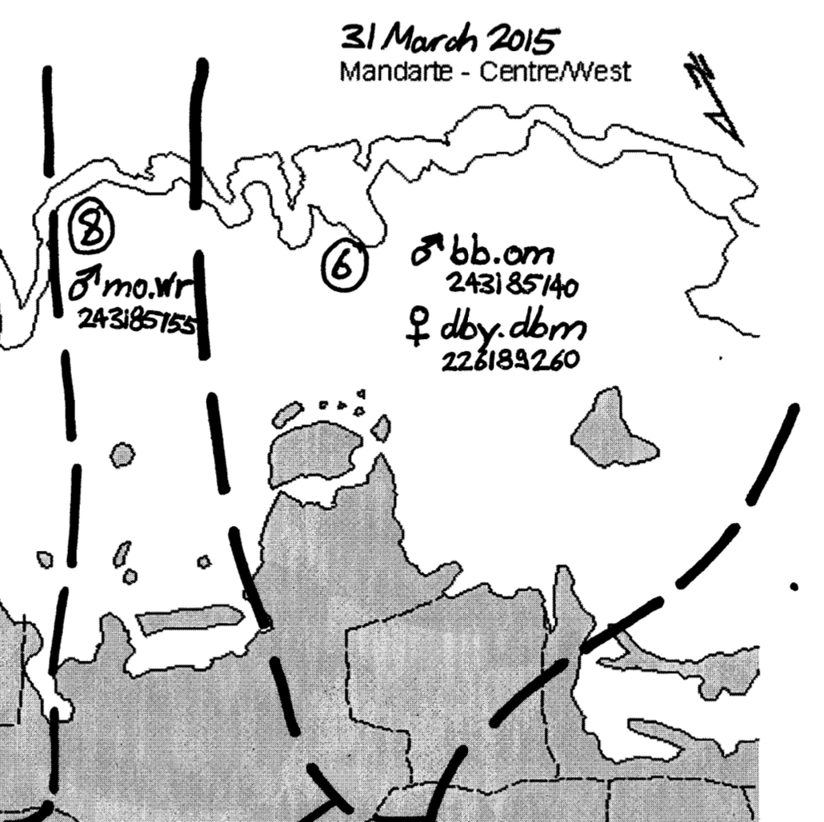
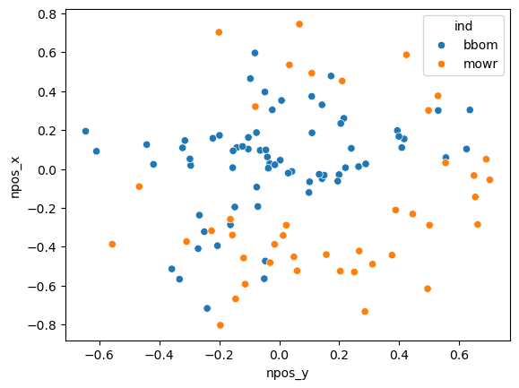
Denoise + Represent
Compare
Visualize

Slide 16
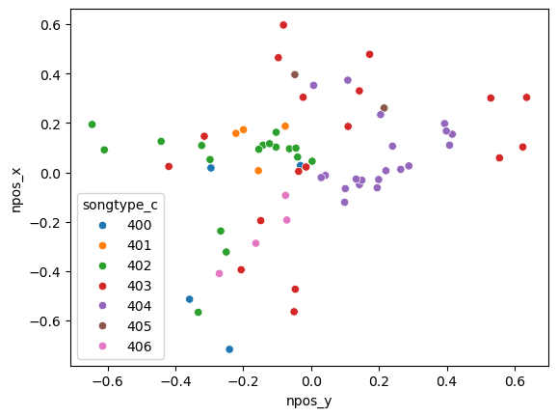
Denoise + Represent
Compare
Visualize
How about human labeled song types?
(Ind: bbom)

Slide 17
Thoughts
Need to fix DTW!
Interesting way to look at bird songs without human labeling (usually these studies are done at the “labeled song” level)
Agnostic to human interpretations of the bird song
Acknowledgement: Christophe for the dataset and discussions!

Slide 18
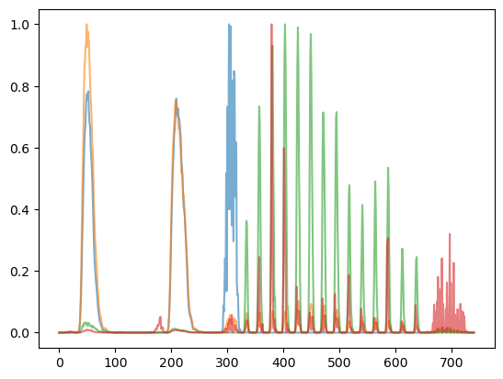
max activity at
each time point

Slide 19
